Slide 1

Customer Shopping Behaviour Analysis
Uncovering insights from 3,900 purchases to drive data-driven decisions

Slide 2
DATASET OVERVIEW
The Foundation
3,900
18
50
Total Purchases
Data Points
Locations
Transactions analyzed
Features per customer
Geographic coverage
Key Features Captured
Customer demographics: Age, Gender, Location
Purchase details: Category, Amount, Season
Shopping behavior: Discounts, Reviews, Frequency
Subscription status and shipping preferences

Slide 3

DATA PREPARATION
Python-Powered Data Cleaning
01
Data Loading & Exploration
Imported dataset, examined structure with df.info() and summary statistics
02
Missing Data Handling
Imputed 37 missing Review Ratings using category median values
03
Feature Engineering
Created age_group bins and purchase_frequency_days columns
04
Database Integration
Loaded cleaned data into PostgreSQL for SQL analysis

Slide 4


KEY METRICS
Customer Profile at a Glance
Average Age
44 years old
Avg Purchase
$59.76 USD
Avg Rating
3.75 stars
Price range: $20-$100 | Age range: 18-70 years

Slide 5
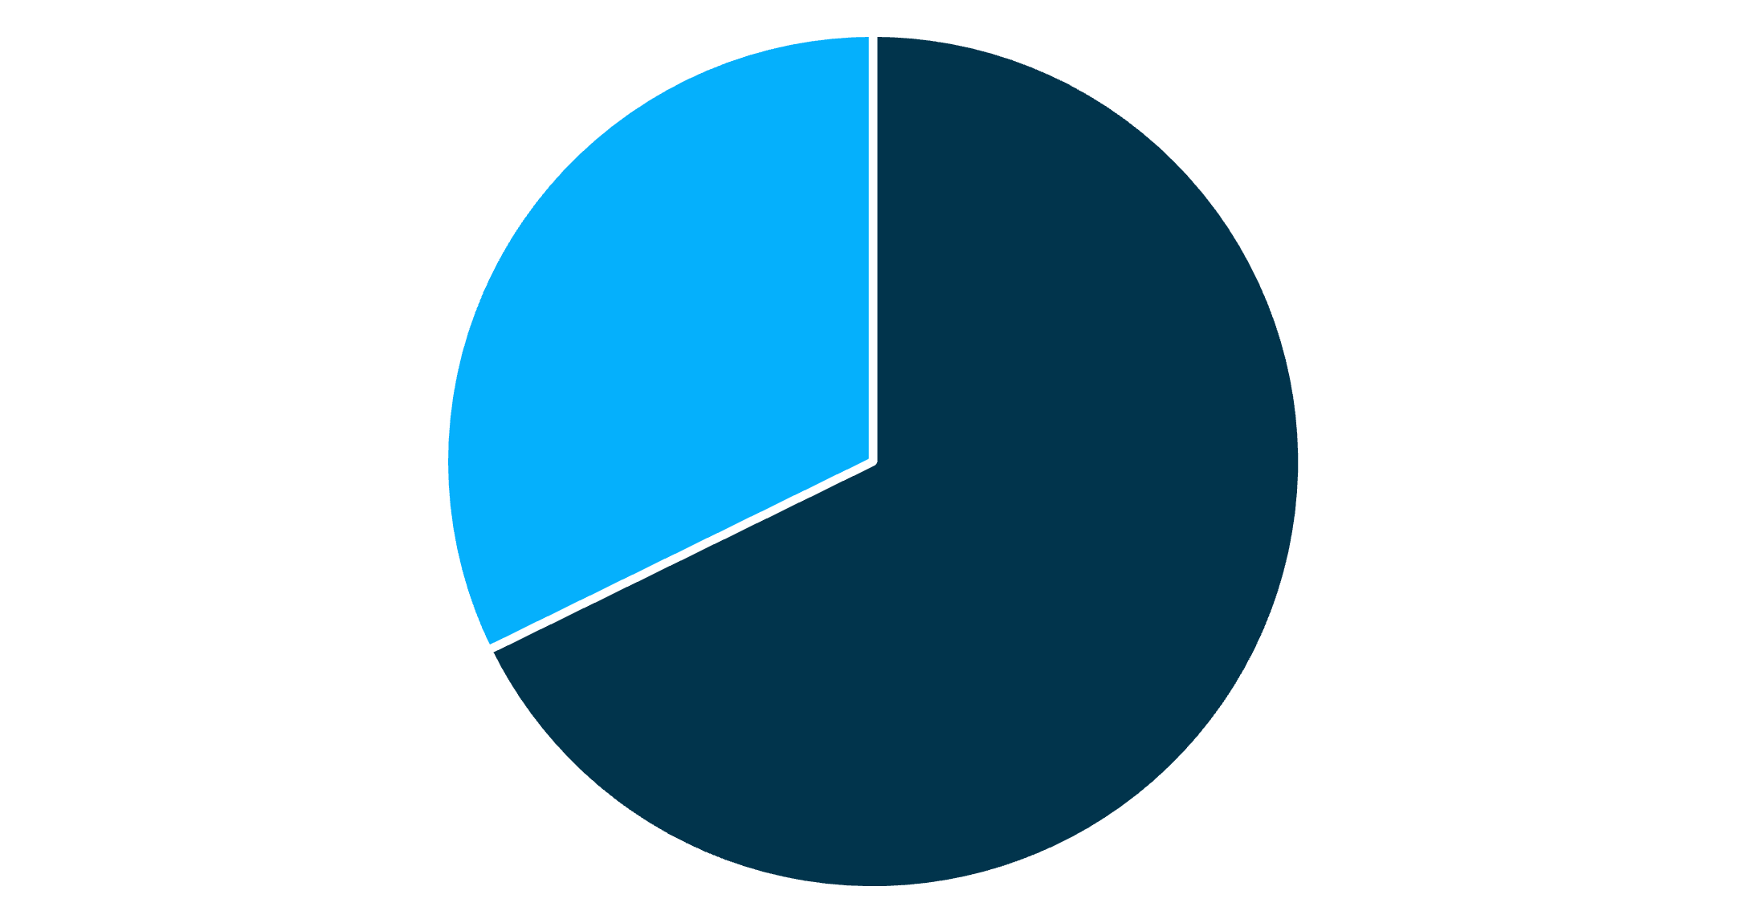
Revenue Insights: Gender & Subscriptions
Gender Distribution
Male customers represent 68% of total customer base and drive 68% of revenue
Subscription Impact
Subscribers: 1,053 customers, $59.49 avg spend
Non-subscribers: 2,847 customers, $59.87 avg spend
Only 27% subscribe despite similar spending patterns
Male
Female

Slide 6





Seasonal Revenue Patterns
Fall
~$60K revenue
Highest season
Spring
~$59K revenue
Slight dip
Winter
~$59K revenue
Stable demand
Summer
~$55K revenue
Lowest season

Slide 7

Product Category Performance
Customer Distribution by Category
Clothing: 1,737 customers (45%)
Accessories: 1,200+ customers (31%)
Footwear: 600+ customers (15%)
Outerwear: 300+ customers (8%)
Top-Rated Products
Gloves (3.86 avg rating)
Sandals (3.84 avg rating)
Boots (3.82 avg rating)

Slide 8
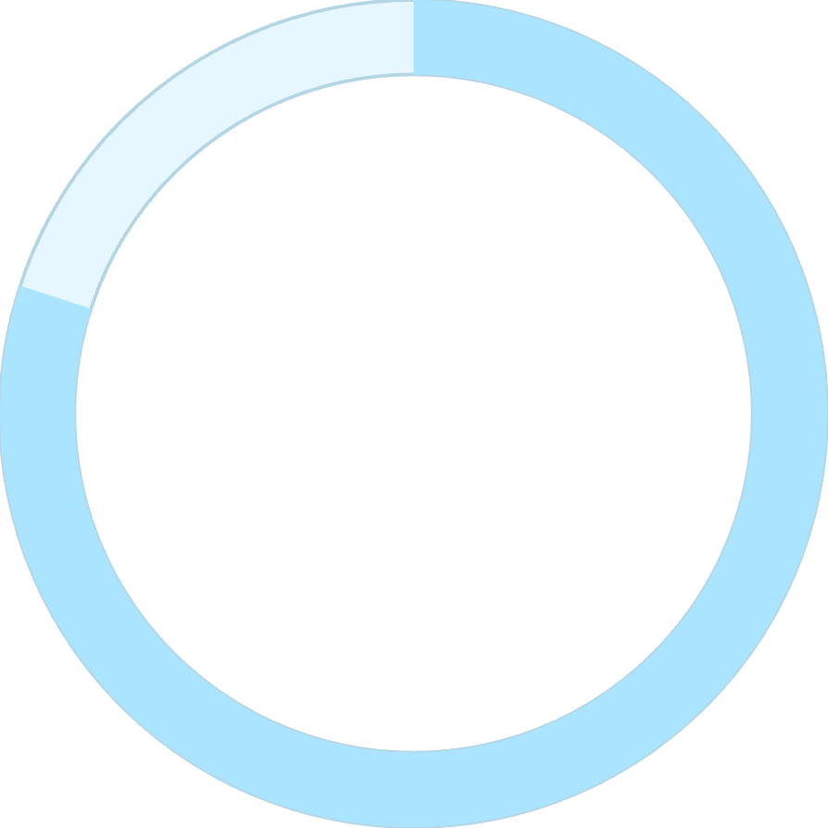
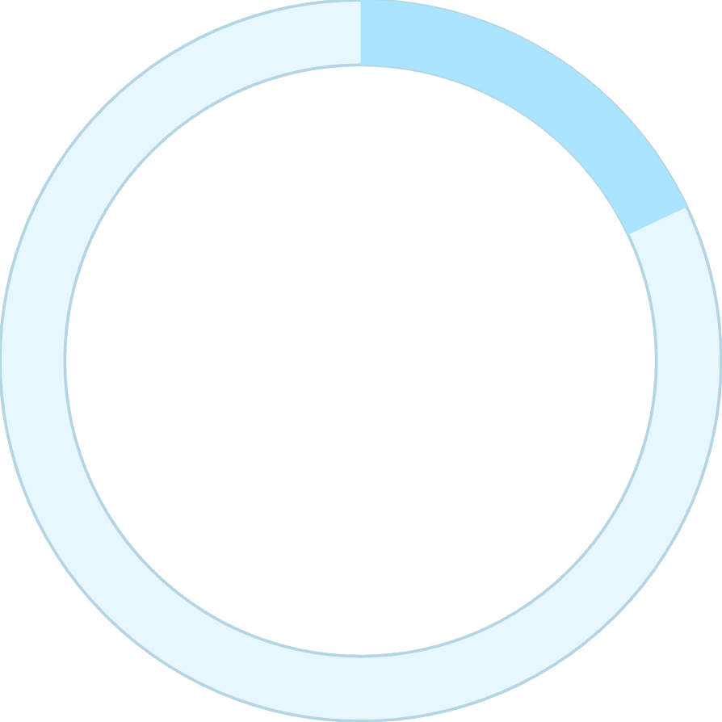

CUSTOMER SEGMENTATION
Loyalty Breakdown
80%
18%
2%
Loyal Customers
Returning
New
3,116 customers with 5+ purchases
701 customers with 2-4 purchases
83 first-time buyers
Strong loyalty base: 80% of customers are repeat buyers with 5+ purchases

Slide 9
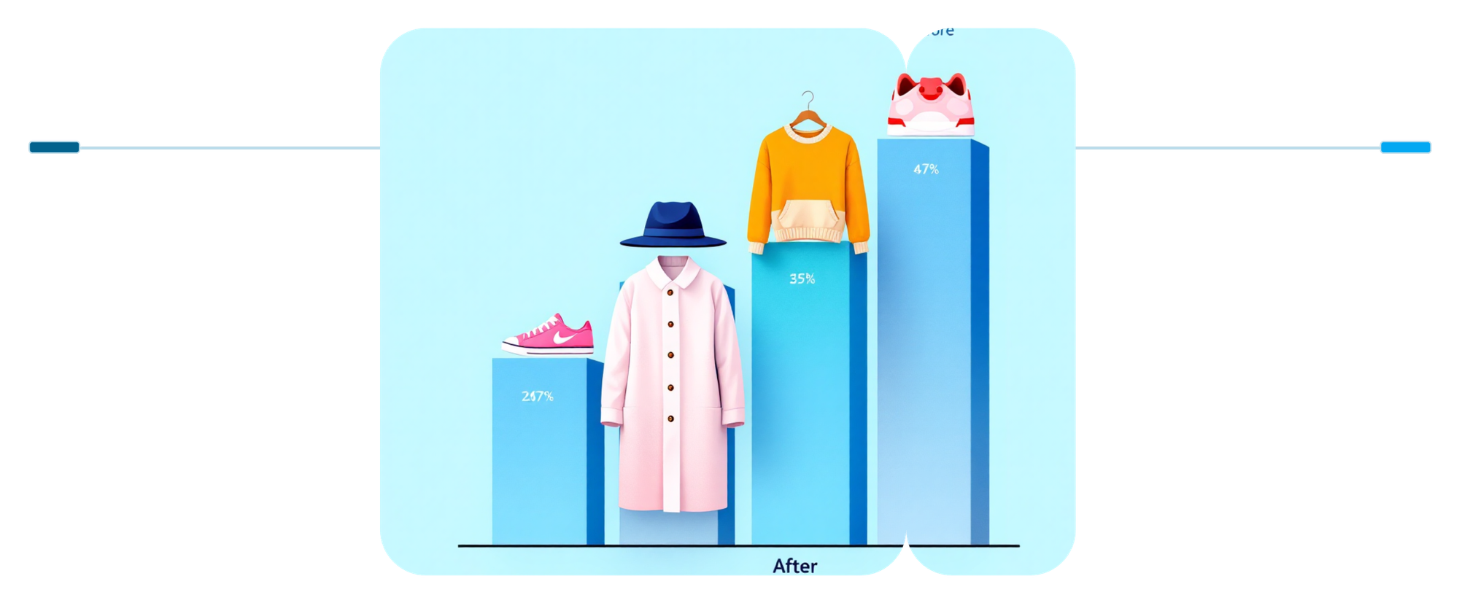
Discount Strategy Analysis
Before Discount
After Discount
Higher sales volume, reduced margins overall
Lower sales volume, higher margins per unit
839 customers used discounts yet spent above average ($59.76)
Discount-Dependent Products
50%
49.7%
Hat
Sneakers
49%
48%
Coat
Sweater
Nearly half of purchases for these items rely on discounts

Slide 10
ACTION ITEMS
Strategic Recommendations
Boost Subscriptions
Loyalty Programs
Optimize Discounts
Only 27% subscribe—promote exclusive benefits to increase conversion
Convert 80% loyal base into subscribers with reward mechanisms
Review 50% discount rates on hats, sneakers, coats to protect margins
Highlight Top Products
Target High-Value Segments
Feature gloves, sandals, boots (highest ratings) in campaigns
Focus on middle-aged customers and express shipping preferences

